Slide 1
SOEN 384
Management, Measurement and Quality Control http://users.encs.concordia.ca/~s384_2/
Lecture 20:
Agile Estimation and Planning(1):
Estimating Size
Mike Cohn, “Agile estimating & planning”, Chapters 3, 4, 5, 6, 7

Slide 2
Course Topics by Areas
(tentative schedule posted)
Part I: Software Engineering Measurement.
    Theoretical, technical and managerial views
Part II: Software Project Management.
    project integration, scope, time, cost, quality, communications, and risk management
Part III: Agile Estimating and Planning.
SOEN384-L20: agile size estimation

Slide 3
The goal of part III of the course:
To provide tools you need to estimate, plan, and manage agile projects of virtually any size
SOEN384-L20: agile size estimation
Notes:
A customer needs estimates to make important prioritization and trade-off decisions

Slide 4
Agenda
The purpose of planning
Why planning fails
An agile approach
Estimating size with story points
Estimating in ideal days
Techniques for estimating
Next?
SOEN384-L20: agile size estimation

Slide 5

The purpose of planning
Goal - to arrive iteratively to an optimal answer to the overall product development question of what to build:
  Features, Resources, Schedule
Planning process = quest for value
  reduce risk, reduce uncertainly, support reliable decision making, convey information, establish trust
SOEN384-L20: agile size estimation
Notes:
Reliable estimates enable reliable delivery
A plan communicates and establishes a set of baseline expectations

Slide 6
Are traditional planning processes always successful?
nearly two-thirds of projects significantly overrun their cost estimates
64% of the features included in products are rarely or never
the average project exceeds its schedule by 100%
SOEN384-L20: agile size estimation

Slide 7
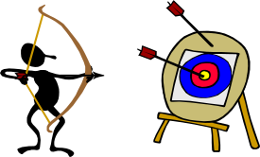

Why traditional planning fails?
Estimates may become commitments
  Estimate is a probability, and a commitment cannot be made to a probability
We ignore uncertainty
  How to deal with it?
    Work in short iterations
SOEN384-L20: agile size estimation
Notes:
We assume that the initial requirements analysis led to a complete and perfect specification of the product. We assume that users will not change their minds, refine their opinions, or come up with new needs during the period covered by the plan
Similarly, we ignore uncertainty about how we will build the product and pretend we can assign precise estimates (“two weeks”) to imprecise work

Slide 8
Agile Manifesto (2001)
Individuals and interpretations over processes and tools
Working software over comprehensive documentation
Customer collaboration over contract negotiation
Responding to change over following a plan
  New product knowledge helps us know more about what the product should be.
  New project knowledge is information about the team, the technologies in use, the risks, and so on.
Agile project managers focus more on leadership than on management
SOEN384-L20: agile size estimation

Slide 9
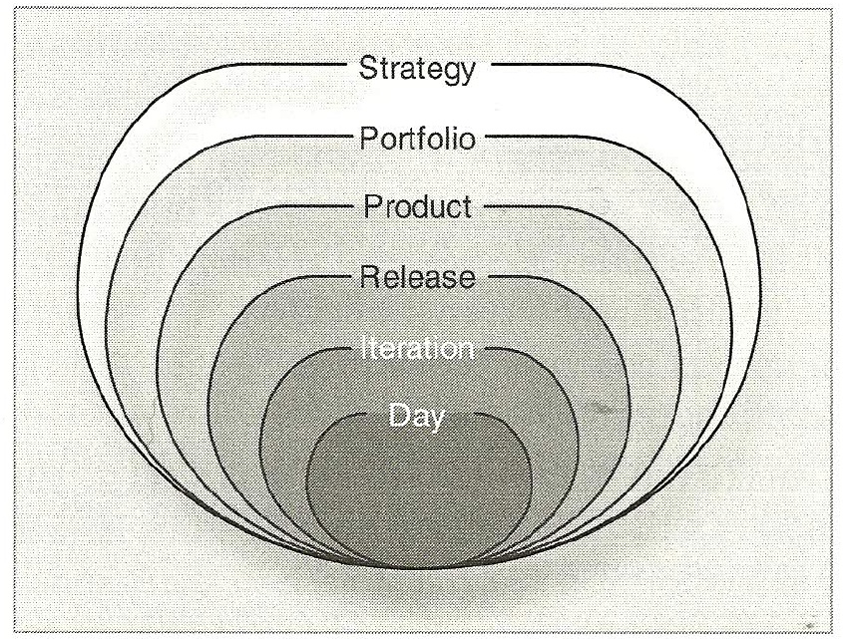

An Agile approach: the planning onion
Agile planning:
  encourages change,
  results in plans that are easily changed,
  is spread throughout the project.
Changing the plan does not mean we change the dates
SOEN384-L20: agile size estimation

Slide 10

Agile Methodology Principles
Work as one team
  Team: product owner, customer, developer, project manager
Work in short iterations
  timeboxed
Deliver user-valued features each iteration
  Focus on business priorities
  User stories
SOEN384-L20: agile size estimation
Notes:
Inspect and adapt

Slide 11
What is a User Story?
Short description of a feature written from the perspective of a user or customer.
Template and example:
  As a <role of user>, I can <capability> so that <benefit>
  As a user, I want to be able to cancel a reservation so that...
Conditions of satisfaction
  A user who cancels more than 24 hours in advance gets a complete refund
  A user who cancels less than 24 hours in advance is refunded all but a $25 cancellation fee
  A cancellation code is displayed on the site and is emailed to the user
SOEN384-L20: agile size estimation
Notes:
A user story is a distinct unit of customer-visible functionality, which does not have to represent value to the business but must represent progress to the customer

Slide 12
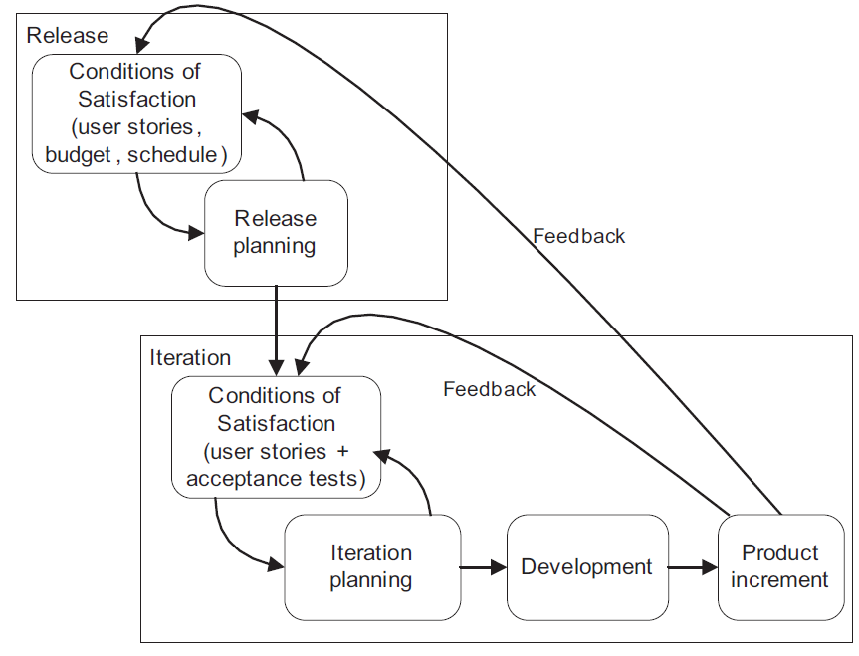
Conditions of satisfaction drive both release and iteration planning
SOEN384-L20: agile size estimation

Slide 13

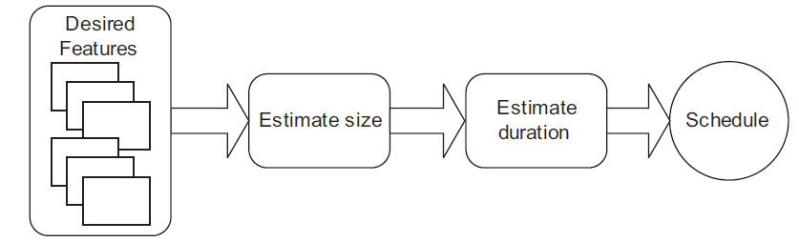

Estimating the duration of a project begins with estimating its size.
Ideal time
Story points
SOEN384-L20: agile size estimation

Slide 14
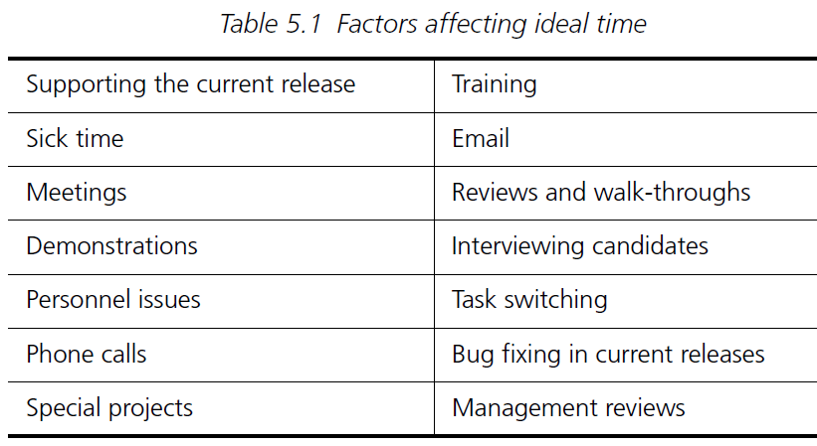
Estimating in ideal days
Ideal time v.s. elapsed time: why are they different?
  When estimating in ideal days you assume that:
  the story being estimated is the only thing you’ll work on
  everything you need will be on hand when you start
  there will be no interruptions
  Similar to Class time v.s. term time
SOEN384-L20: agile size estimation
Notes:
On a software project, ideal time differs from elapsed time. On any given day, in addition to working on the planned
activities of a project, a team member may spend time answering email, making
a support call to a vendor, interviewing a candidate for the open analyst position,
and in two meetings.

Slide 15

Estimating size with story points
Probably the most commonly used estimating unit among agile teams today
Name is derived from agile teams commonly expressing requirements as “user stories”
Based on a combination of the size and complexity of the work
A 10-point user story is expected to take twice as long as a 5-point user story
SOEN384-L20: agile size estimation

Slide 16

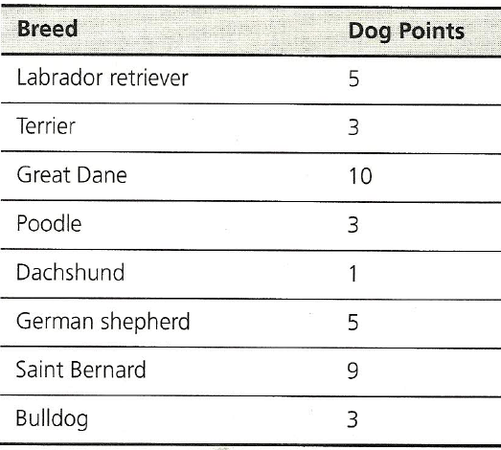


Estimating size with story points
Estimation is relative ☺
Use range of [1..10]
SOEN384-L20: agile size estimation

Slide 17

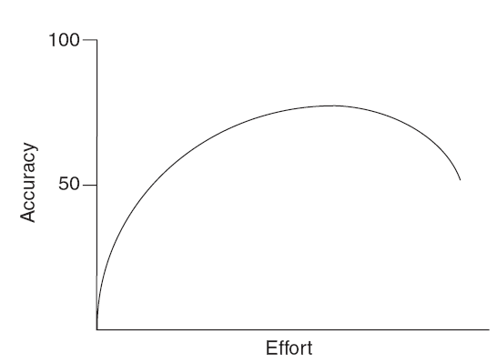
Techniques for estimating
Be aware of the law of diminishing returns on time spent estimating
estimation scales:
  Fibonacci: 1, 2, 3, 5, 8
  1, 2, 4, 8
NOTE: may exist a 0-point story
    The equivalent of a free lunch
    13 * 0?
SOEN384-L20: agile size estimation
Notes:
An alternative to using 0 is to group very small stories
together and estimate them as a single unit.

Slide 18
Deriving an estimate - Planning poker technique
An iterative approach to estimating, loosely based on wideband Delphi
Steps
1. Each estimator is given a deck of cards, each card has a valid estimate written on it
2. Customer/Product owner reads a story and it’s discussed briefly
3. Each estimator selects a card that’s his or her estimate
4. Cards are turned over so all can see them
5. Discuss differences (especially outliers)
6. Re-estimate until estimates converge
SOEN384-L20: agile size estimation

Slide 19
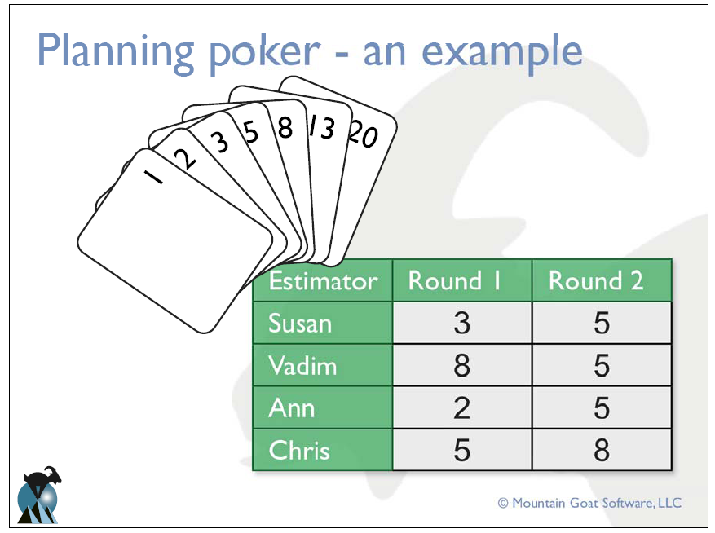

SOEN384-L20: agile size estimation

Slide 20
Estimating in story points:
Three key advantages
1. Forces the use of relative estimating
  Studies have shown we’re better at this
2. Puts estimates in units that we can add together
3. Completely separates the estimation of effort from the estimation of duration
We derive duration empirically by seeing how much we complete per iteration
SOEN384-L20: agile size estimation

Slide 21
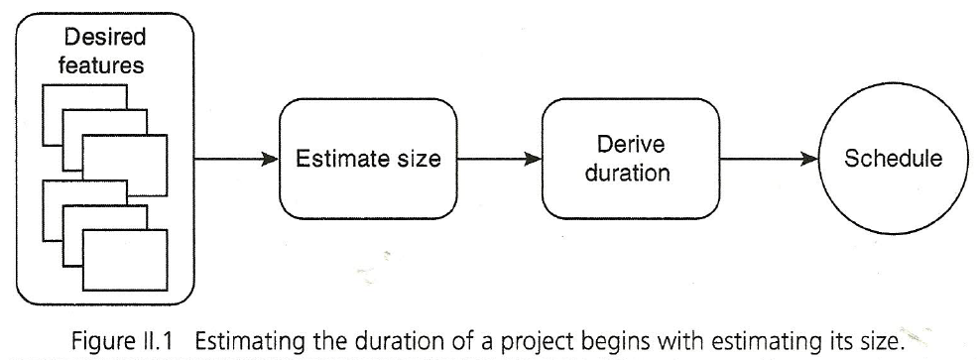
Estimating in story points: size v.s. velocity & duration
  Do not give partial credit for partially completed user stories
Velocity=team’s rate of progress [story points per iteration]
10 story points/[5 story points per iteration] = 2 iterations
SOEN384-L20: agile size estimation

Slide 22
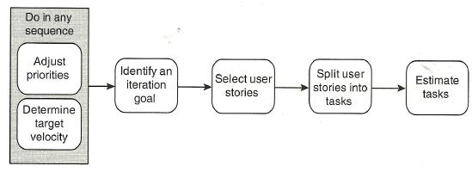
Velocity-driven iteration planning
Size of a task?
Hint: each developer should be able to finish an average of one task per day
SOEN384-L20: agile size estimation
Notes:
Velocity is a measure of a team’s rate of progress per iteration

Slide 23
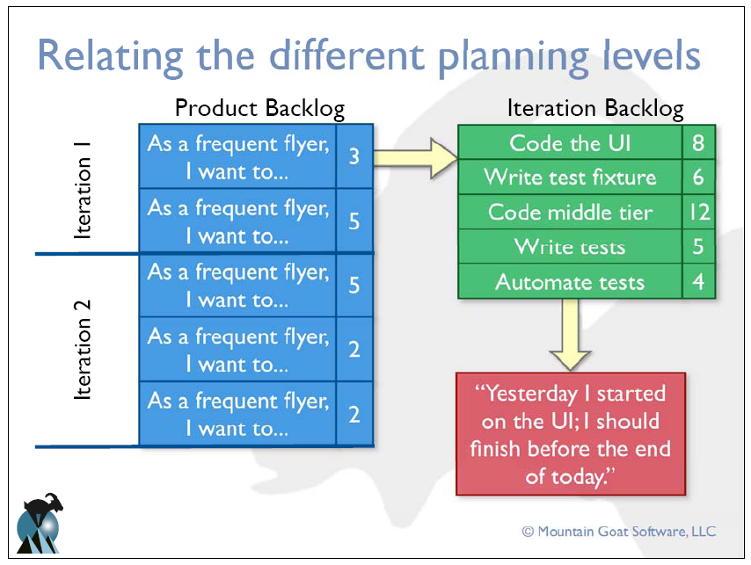
SOEN384-L20: agile size estimation

Slide 24
Learning Objectives of this lecture:
Agile principles
    User stories backlog
    How to estimate user stories size in story points
    Planning poker
Notion of velocity
    Planning levels in Agile projects
How to plan iterations and determine your team’s initial rate of progress (velocity)
SOEN384-L20: agile size estimation

Slide 25
Agile world common questions
(will be discussed next class)
How do I plan for large teams?
What size iteration should we use?
How should I report progress to management?
How do I prioritize stories?
How do I get the big picture of the project?
SOEN384-L20: agile size estimation

Slide 26
Exercises
Who should participate in the planning poker on your project?
Suppose a project has 90 story points in total. Over the first 4 iterations the team has achieved a velocity of 6, 20, 10, and 17. You are asked when the project will be done. What do you say?
SOEN384-L20: agile size estimation

Slide 27
Questions?
…
SOEN384-L20: agile size estimation

Slide 28
Next?
Read Mike Cohn, “Agile estimating & planning”, Chapters 3, 4, 5, 6, 7
5 min quiz (0%) on:
  agile principles
  agile planning levels (release, iteration, day; how to relate different levels)
  estimating size with story points
  planning poker
Lecture 21: Planning for value
SOEN384-L20: agile size estimation

